Slide 1
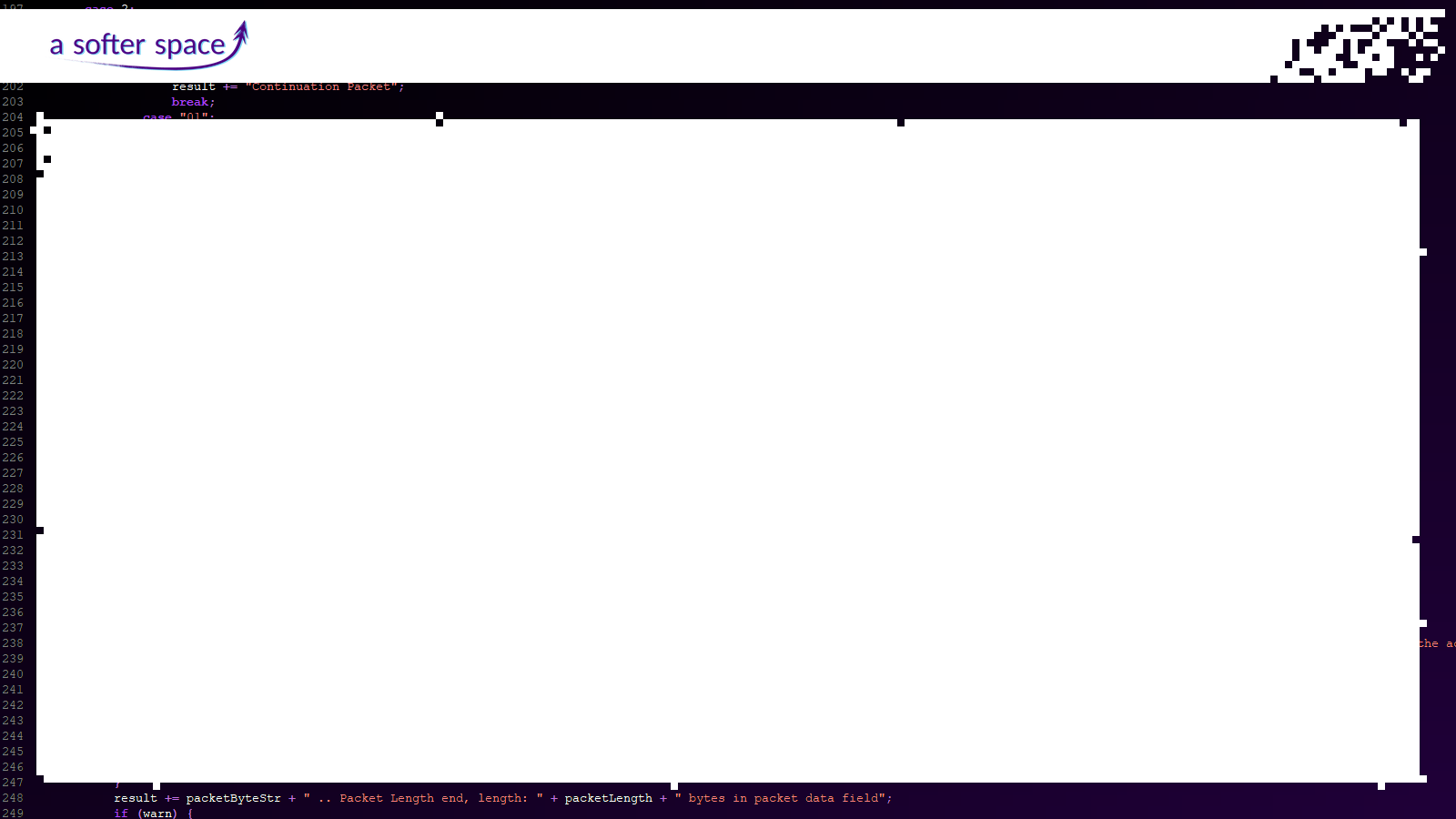
Rewinding the Clock
Playback Concepts in EGS-CC
Tom Moya Schiller
A Softer Space
ESAW
May 2019

Slide 2
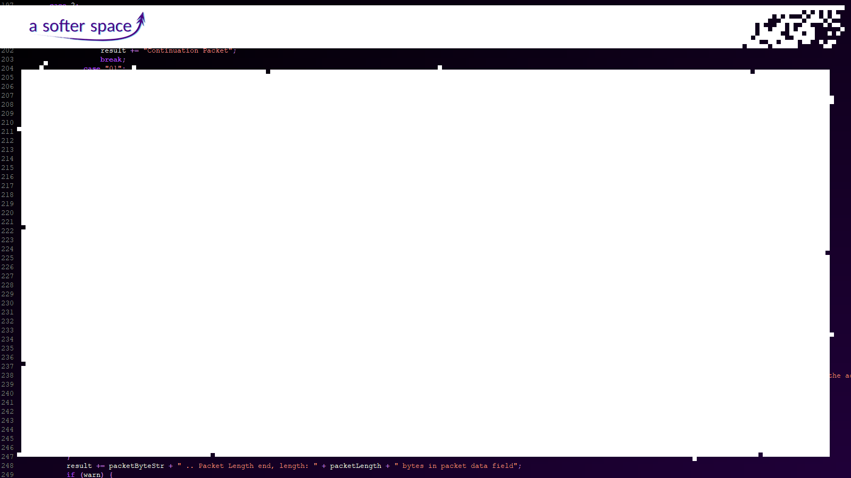
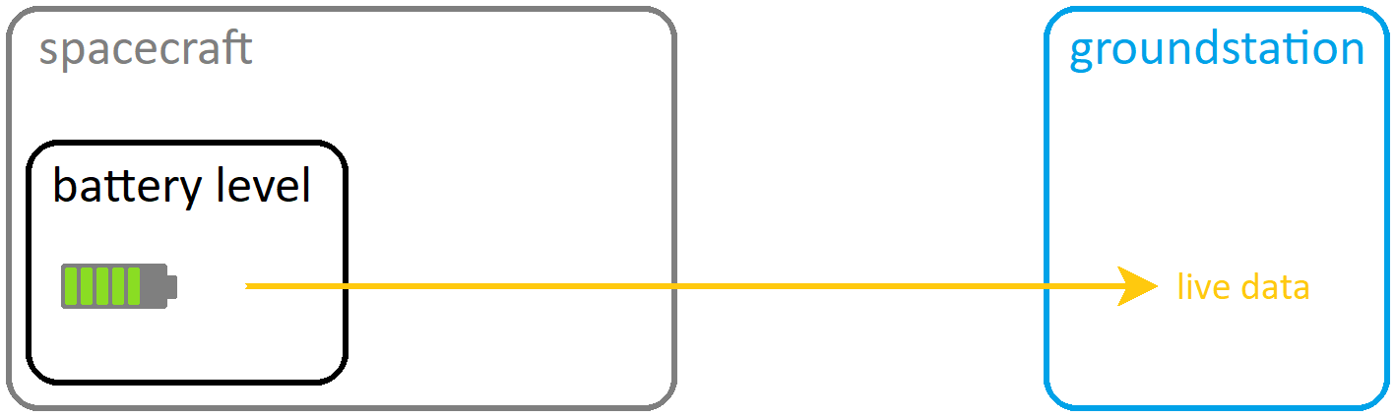
Rewinding the Clock: Playback Concepts in EGS-CC
Ideally, live data arrives from the spacecraft unhindered:

Slide 3
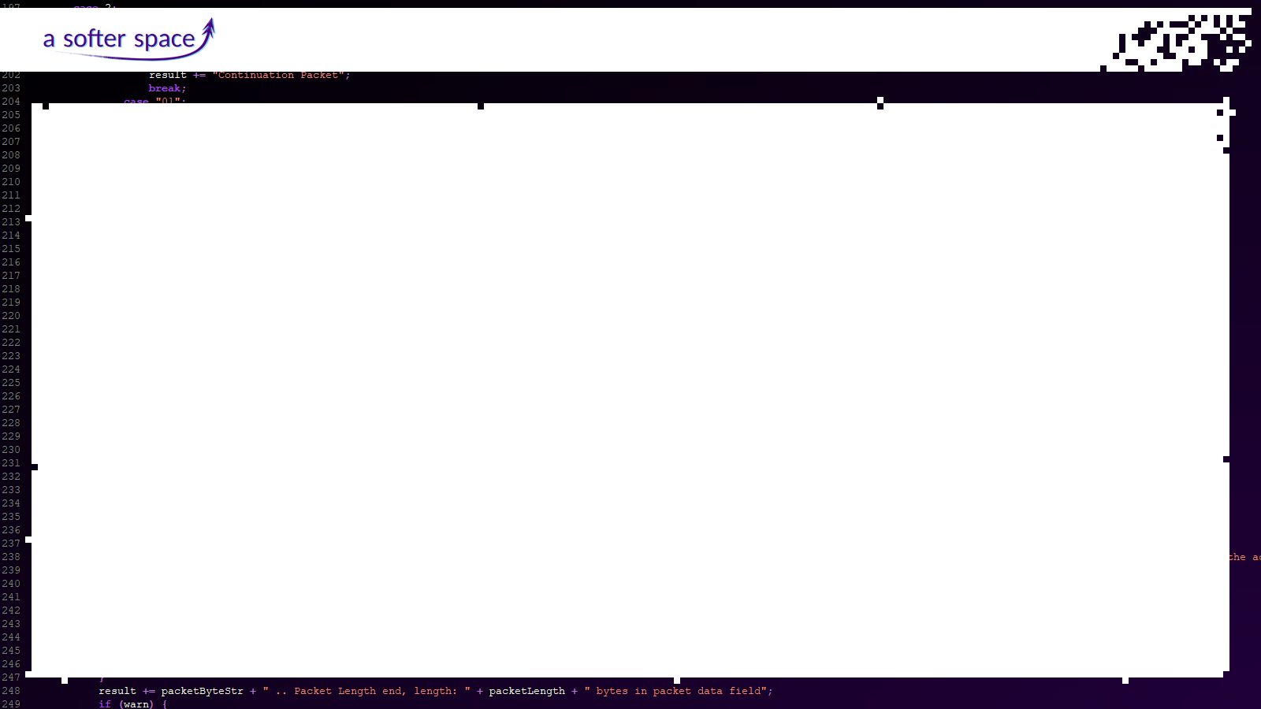
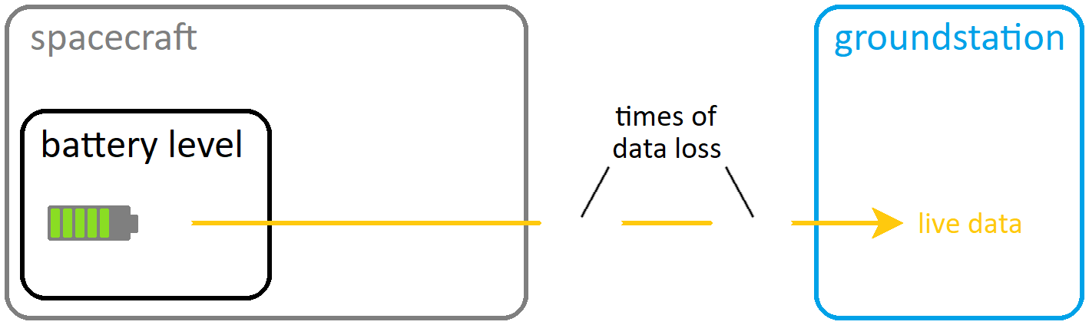
Rewinding the Clock: Playback Concepts in EGS-CC
Missions with small windows of visibility cannot constantly receive live data:

Slide 4
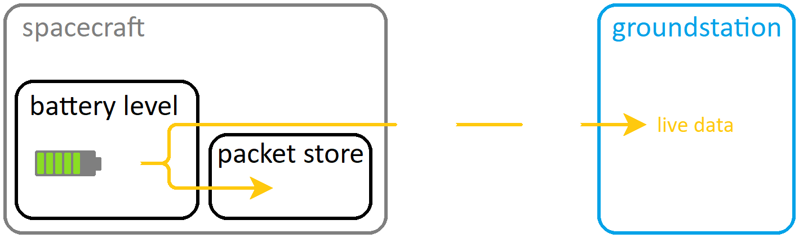
Rewinding the Clock: Playback Concepts in EGS-CC
Therefore, data is stored on board…

Slide 5
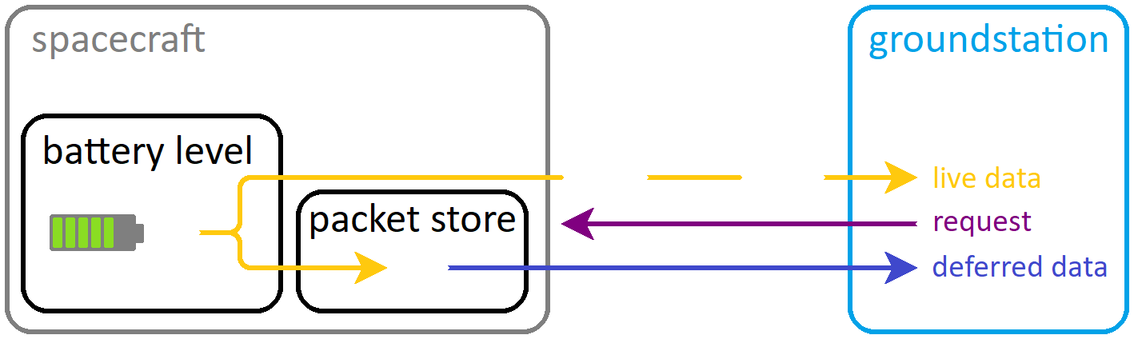
Rewinding the Clock: Playback Concepts in EGS-CC
... and downlinked upon request using PUS 15:

Slide 6
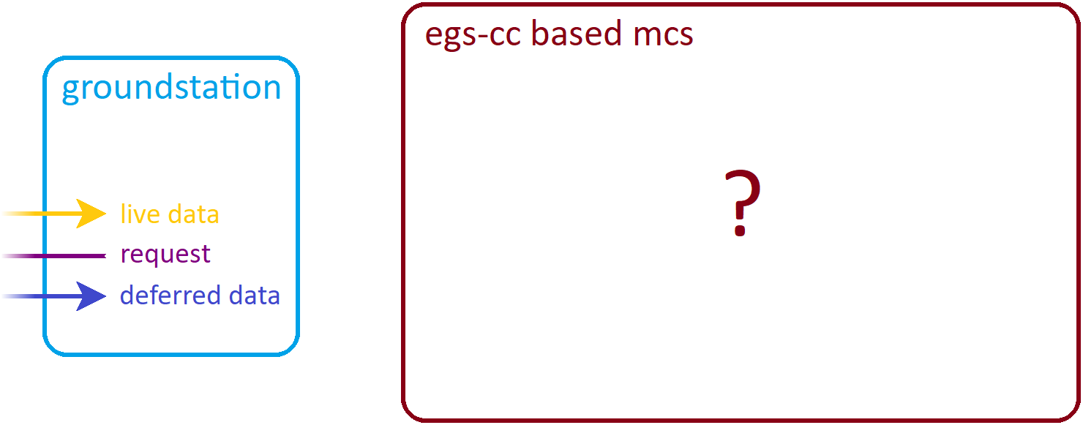
Rewinding the Clock: Playback Concepts in EGS-CC
How does a monitoring & control system based on the EGS-CC handle this?

Slide 7
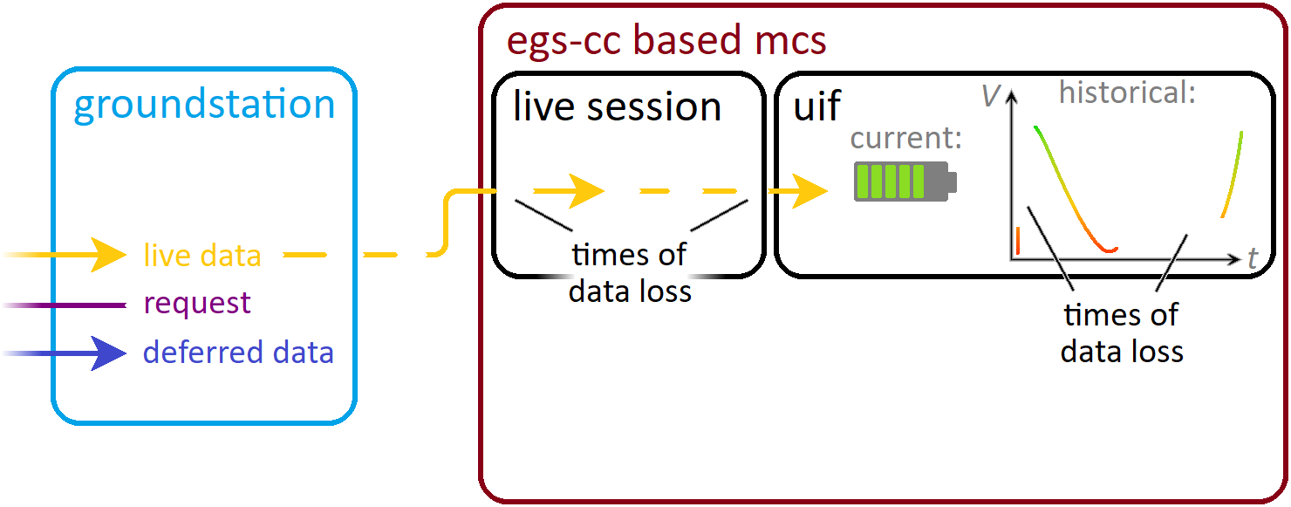
Rewinding the Clock: Playback Concepts in EGS-CC
Session concept, basic case - one live session:

Slide 8
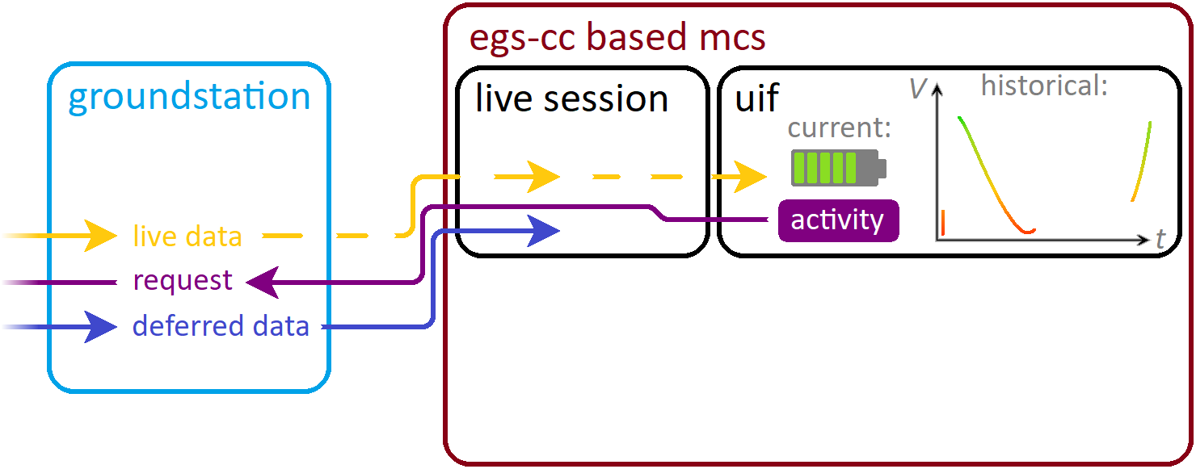
Rewinding the Clock: Playback Concepts in EGS-CC
Live session also requests and stores deferred data:

Slide 9
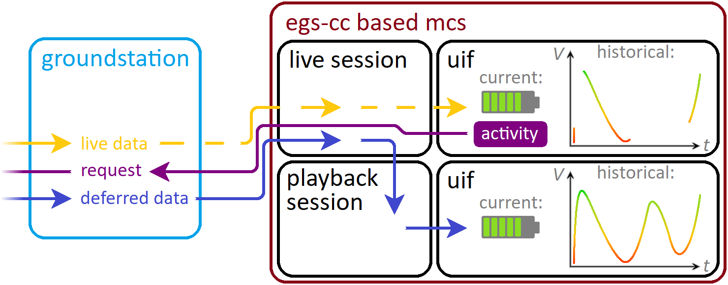
Rewinding the Clock: Playback Concepts in EGS-CC
Playback session uses deferred data for complete history:

Slide 10
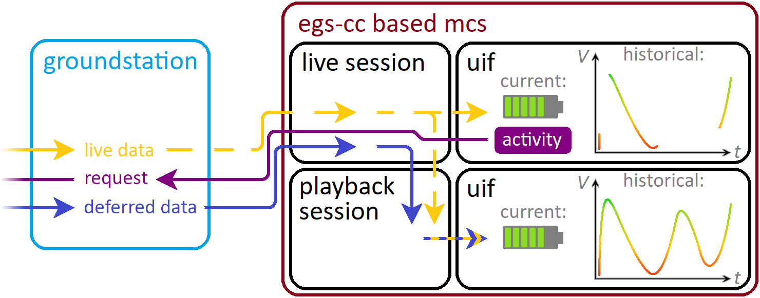
Rewinding the Clock: Playback Concepts in EGS-CC
Mix of live and deferred data in playback session also configurable:

Slide 11
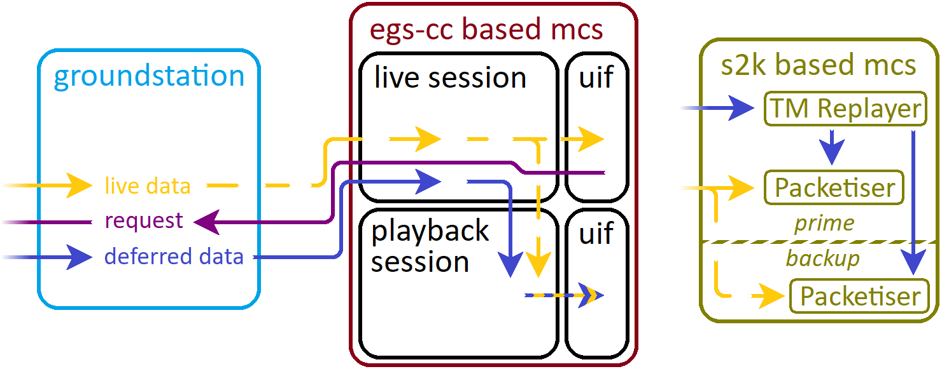
Rewinding the Clock: Playback Concepts in EGS-CC
Live and playback sessions independent –
different from SCOS-2000 where TM Replayer runs inside live system:

Slide 12

Rewinding the Clock: Playback Concepts in EGS-CC
Overview of different types of sessions in EGS-CC:

Slide 13
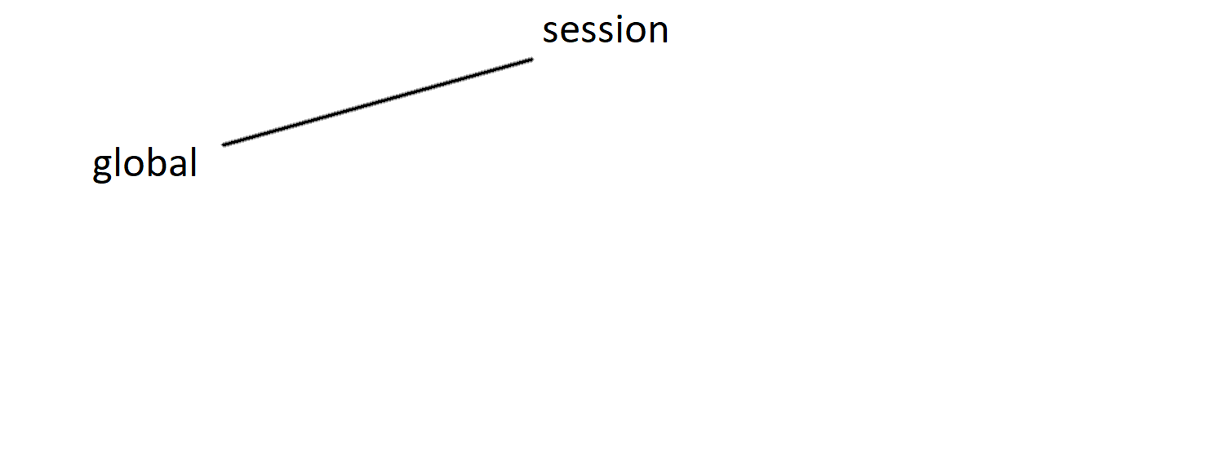
Rewinding the Clock: Playback Concepts in EGS-CC
Surrounding global container – connected before joining specific session:

Slide 14
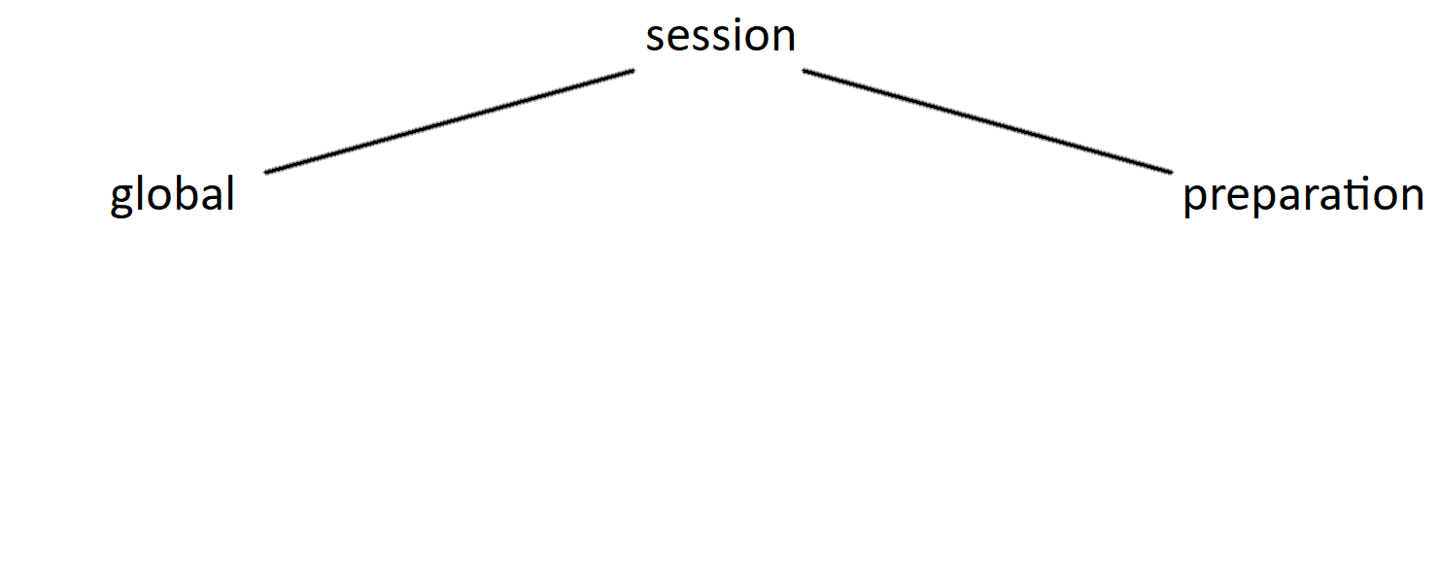
Rewinding the Clock: Playback Concepts in EGS-CC
Preparation session used to prepare SOBs, UDDs, etc. offline:

Slide 15
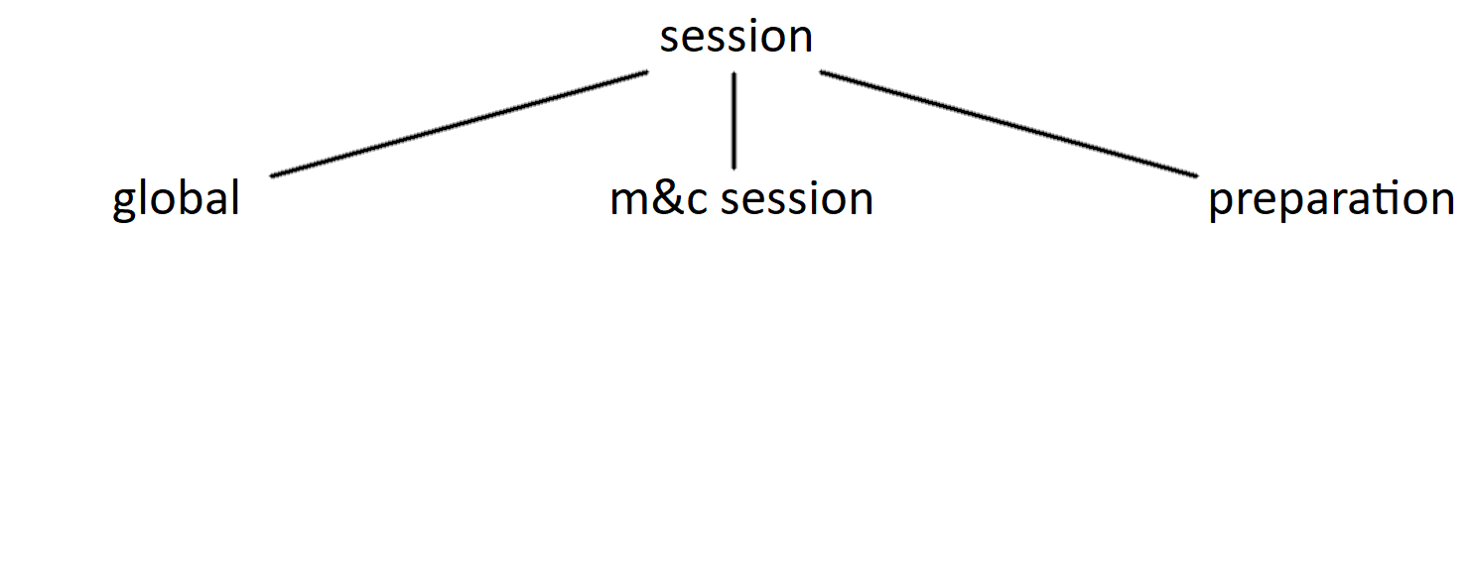
Rewinding the Clock: Playback Concepts in EGS-CC
Each monitoring and control session like one instance of SCOS-2000:

Slide 16
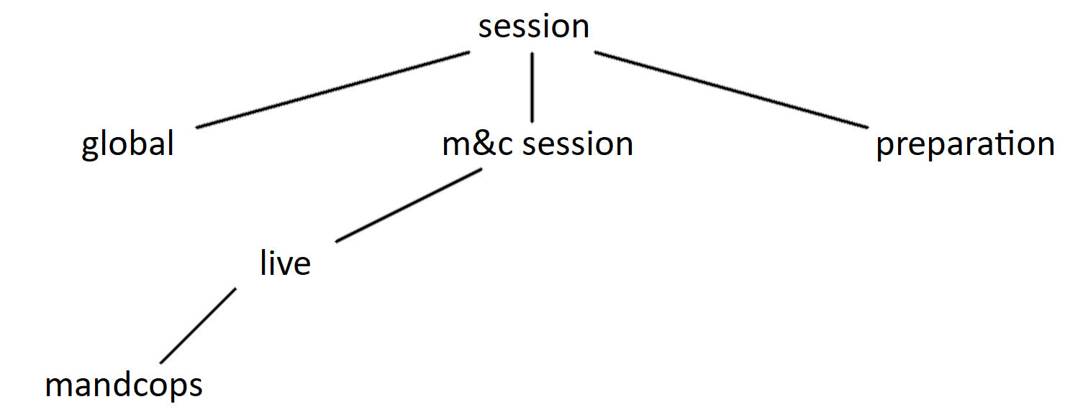
Rewinding the Clock: Playback Concepts in EGS-CC
Live mandcops session shows (and expects) live data only:

Slide 17
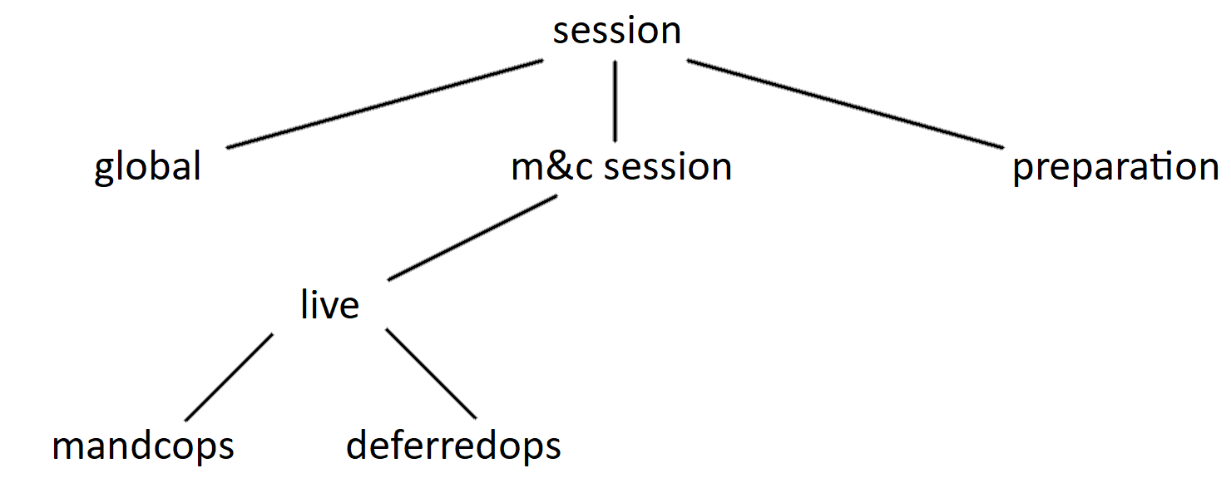
Rewinding the Clock: Playback Concepts in EGS-CC
Deferredops session expects deferred data to arrive, behaves like mandcops:

Slide 18
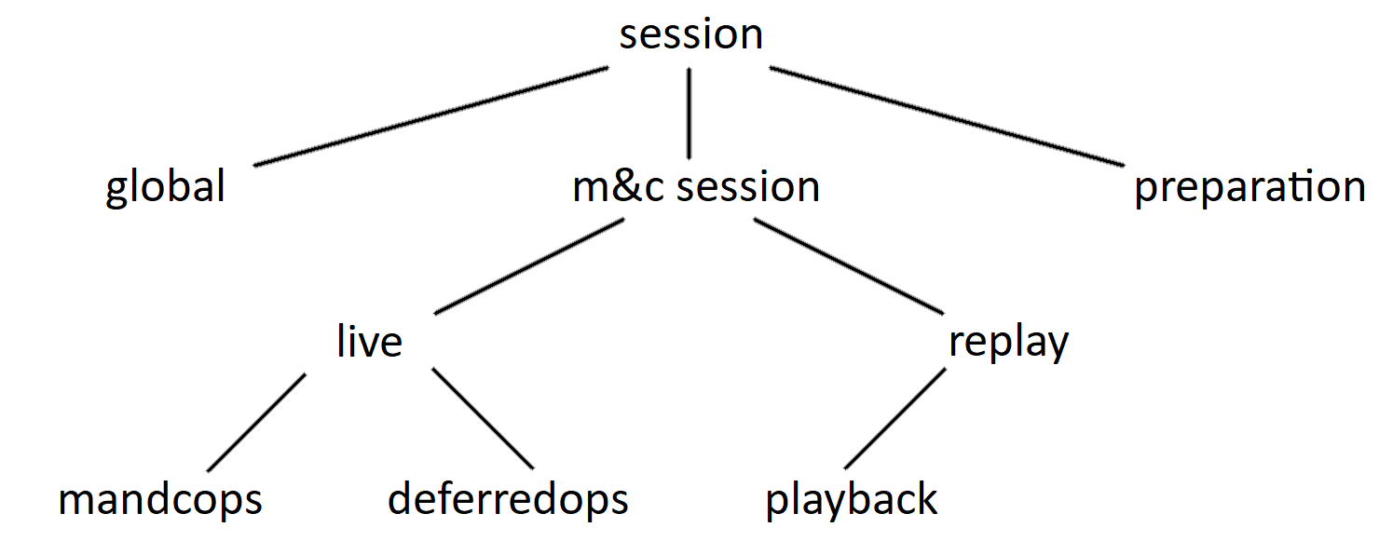
Rewinding the Clock: Playback Concepts in EGS-CC
Playback session plays back deferred data to achieve complete history:

Slide 19
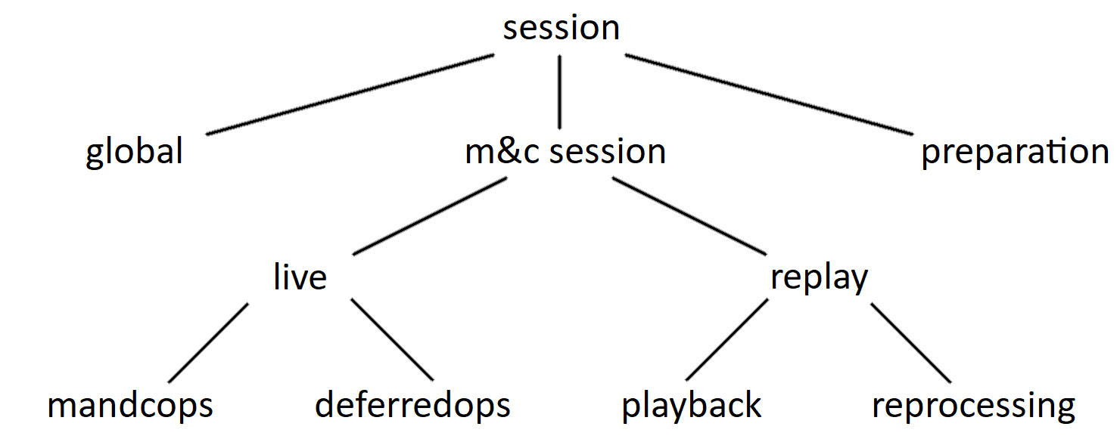
Rewinding the Clock: Playback Concepts in EGS-CC
Reprocessing session processes same data again, e.g. with updated tailoring:

Slide 20
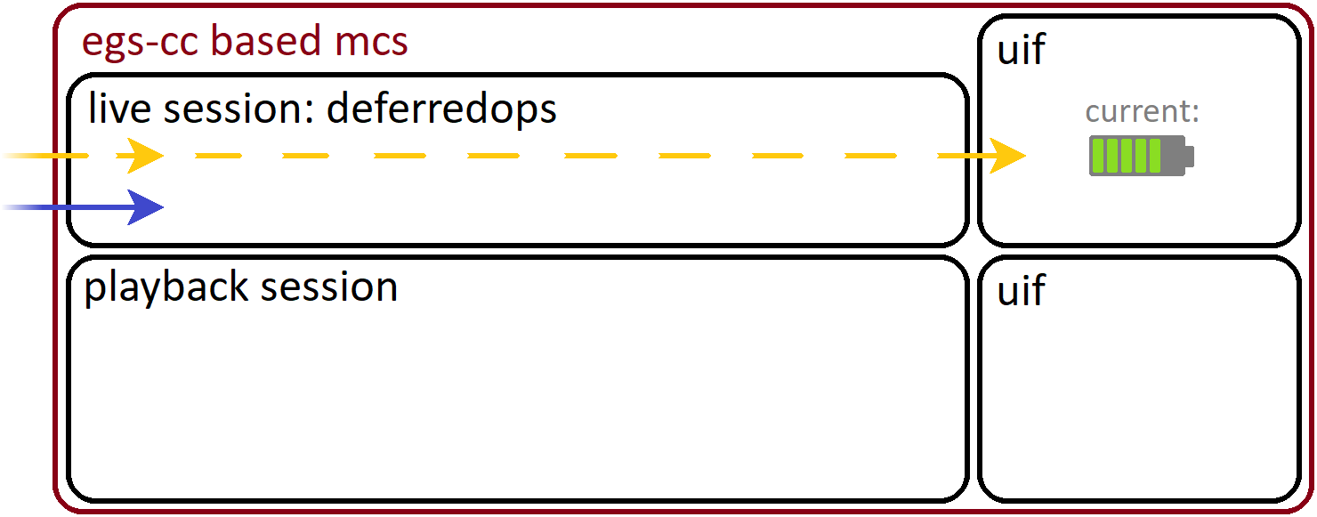
Rewinding the Clock: Playback Concepts in EGS-CC
So how does data flow inside live and playback session?

Slide 21
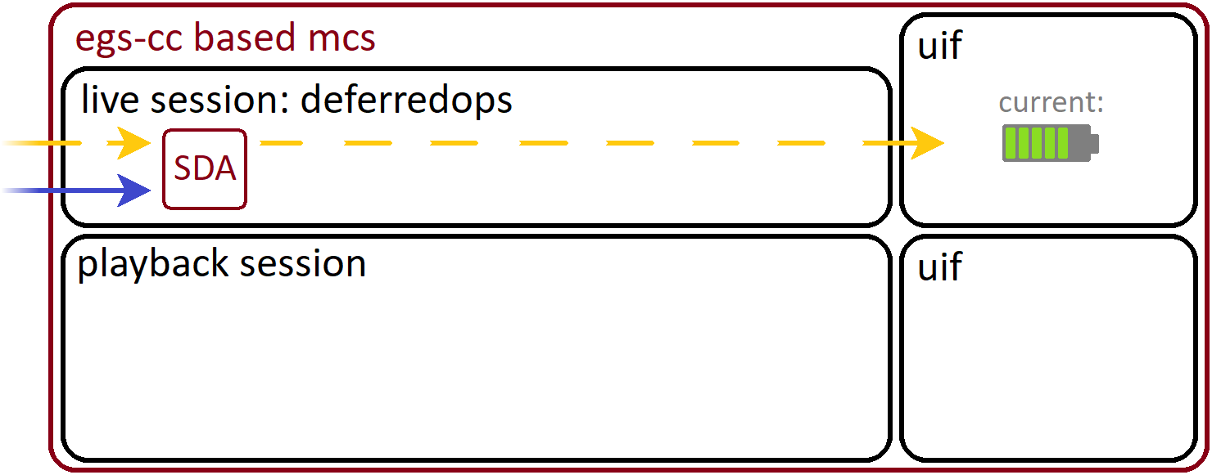
Rewinding the Clock: Playback Concepts in EGS-CC
All data – live and playback – goes through Source Data Access (SDA)…

Slide 22
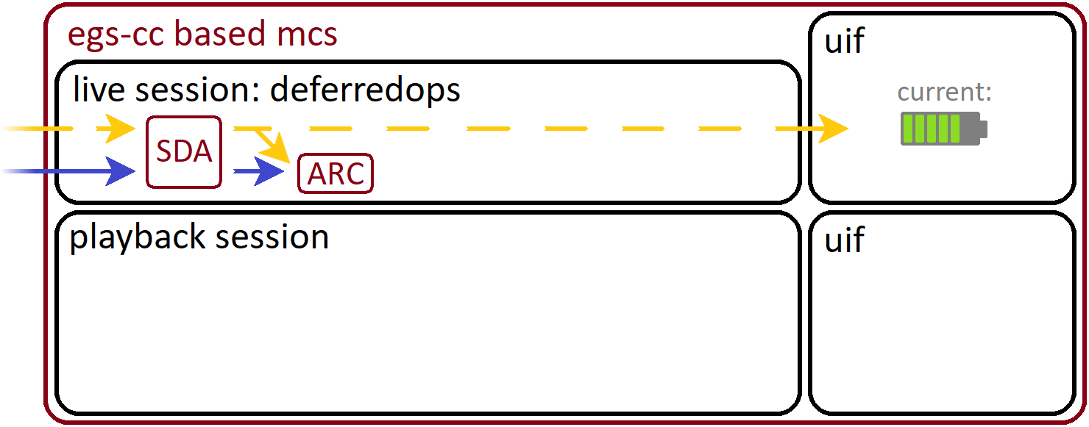
Rewinding the Clock: Playback Concepts in EGS-CC
… and gets stored in the archive (ARC)

Slide 23
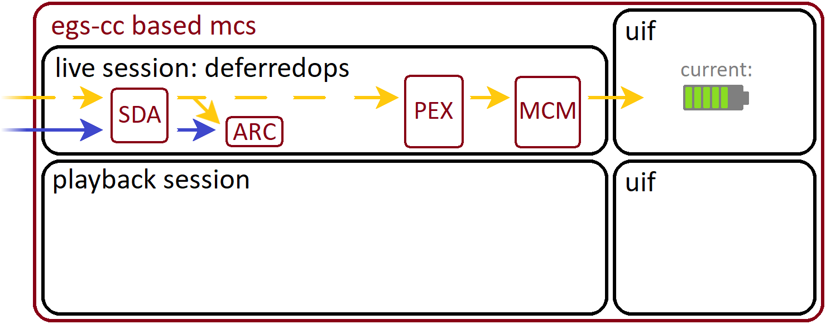
Rewinding the Clock: Playback Concepts in EGS-CC
Live data flows through PEX and MCM for the current (live) view:

Slide 24
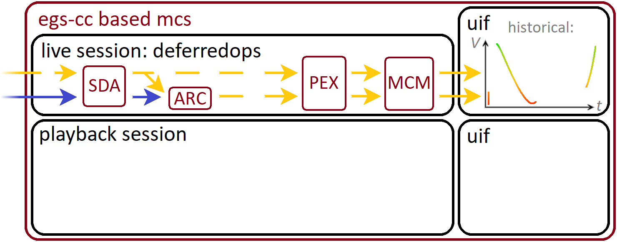
Rewinding the Clock: Playback Concepts in EGS-CC
Archived live data is used to construct an incomplete historical view:

Slide 25
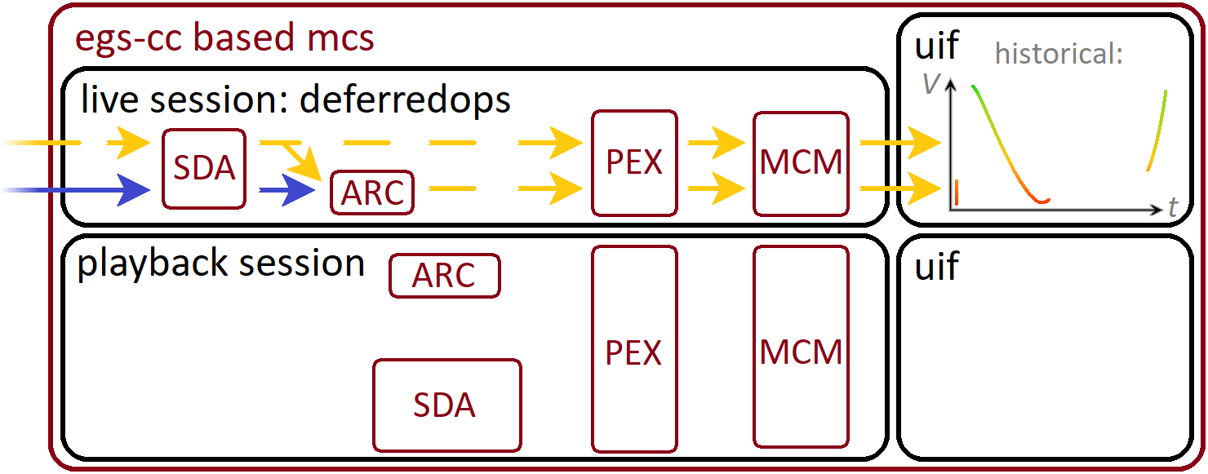
Rewinding the Clock: Playback Concepts in EGS-CC
The playback session contains mostly the same components:

Slide 26
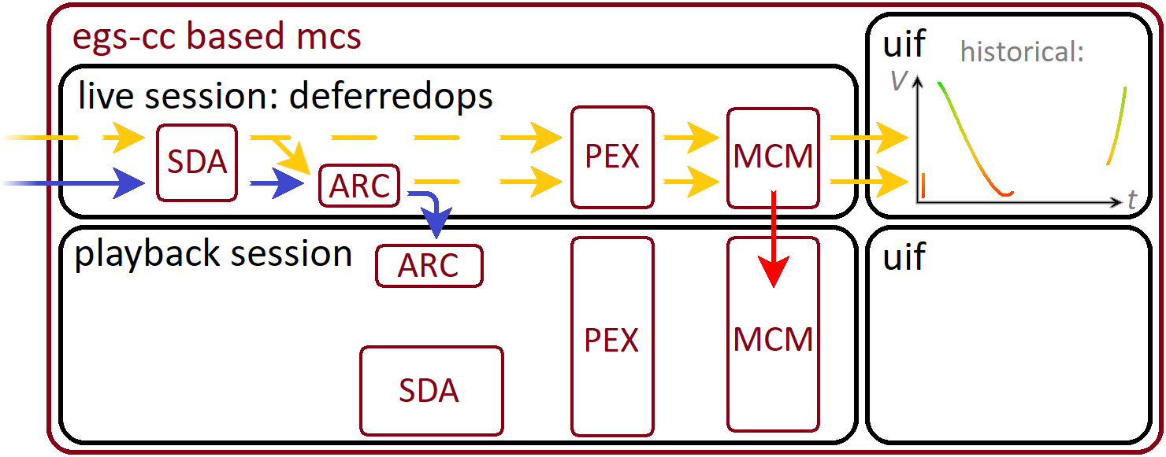
Rewinding the Clock: Playback Concepts in EGS-CC
Source data moves via ARC, other data via MCM Input Archive:

Slide 27
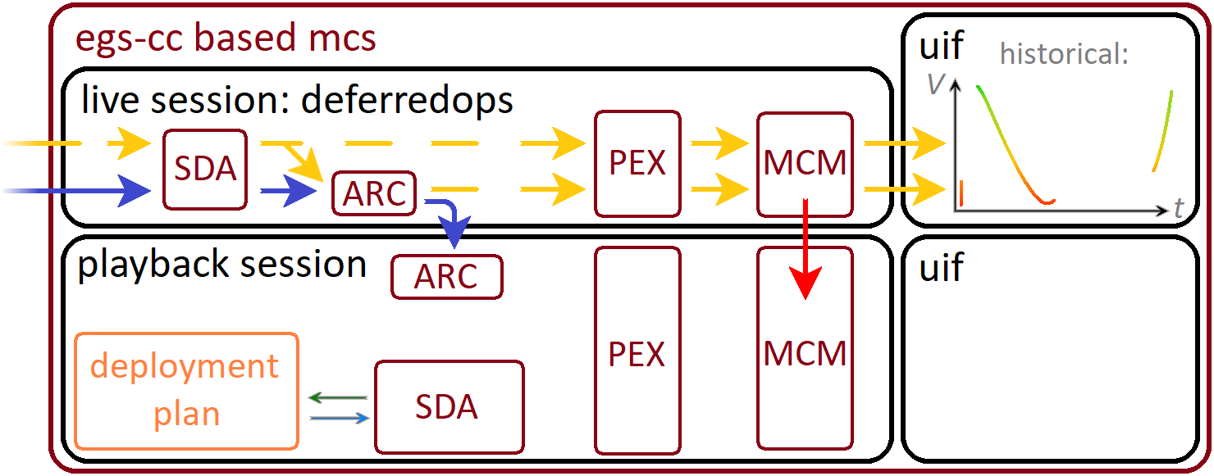
Rewinding the Clock: Playback Concepts in EGS-CC
SDA obtains data about the playback behavior from the deployment plan:

Slide 28
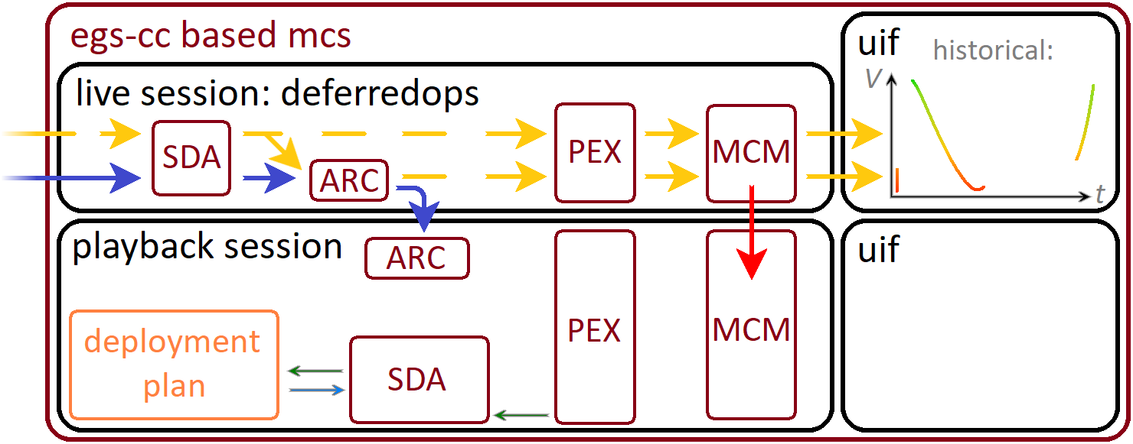
Rewinding the Clock: Playback Concepts in EGS-CC
PEX registers itself as playback listener to SDA:

Slide 29

Rewinding the Clock: Playback Concepts in EGS-CC
SDA iterates through time in short time steps, telling PEX about the first one:

Slide 30

Rewinding the Clock: Playback Concepts in EGS-CC
PEX requests from SDA the data for the first step, which requests it from ARC:

Slide 31
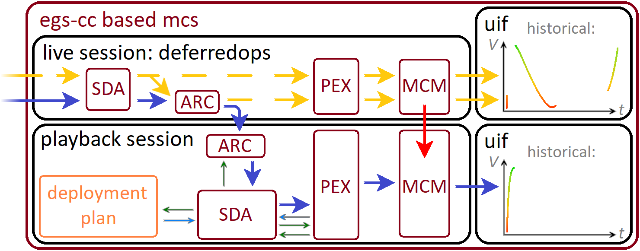
Rewinding the Clock: Playback Concepts in EGS-CC
The deferred data of the first step flows from ARC all the way to the UIF:

Slide 32
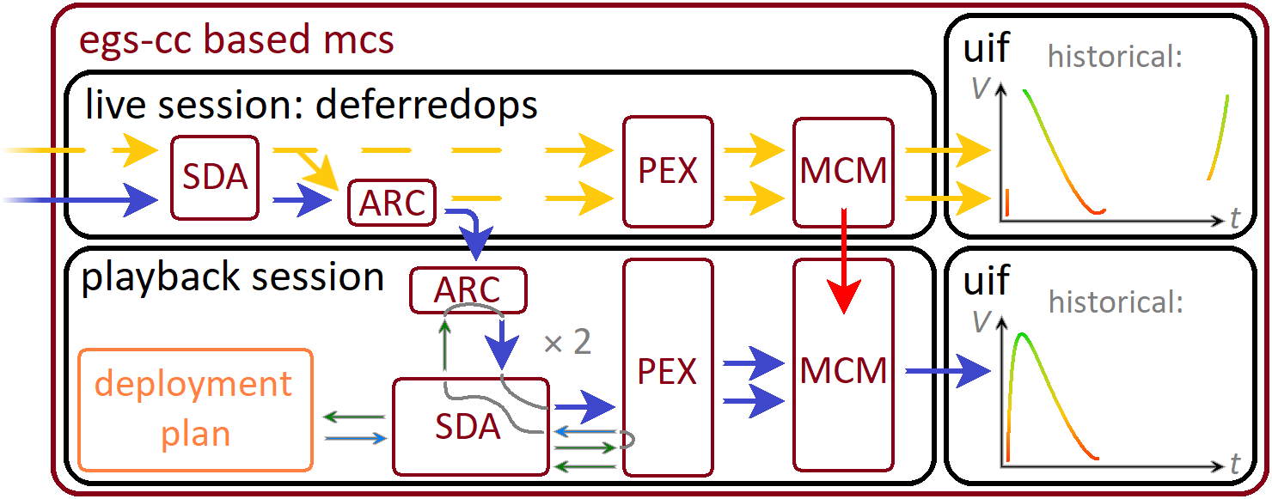
Rewinding the Clock: Playback Concepts in EGS-CC
For each time step, SDA → PEX → SDA → ARC → SDA → PEX loop repeats:

Slide 33
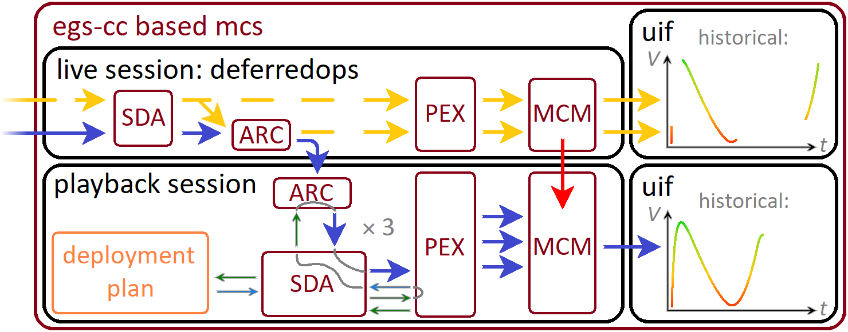
Rewinding the Clock: Playback Concepts in EGS-CC
For each time step, SDA → PEX → SDA → ARC → SDA → PEX loop repeats:

Slide 34
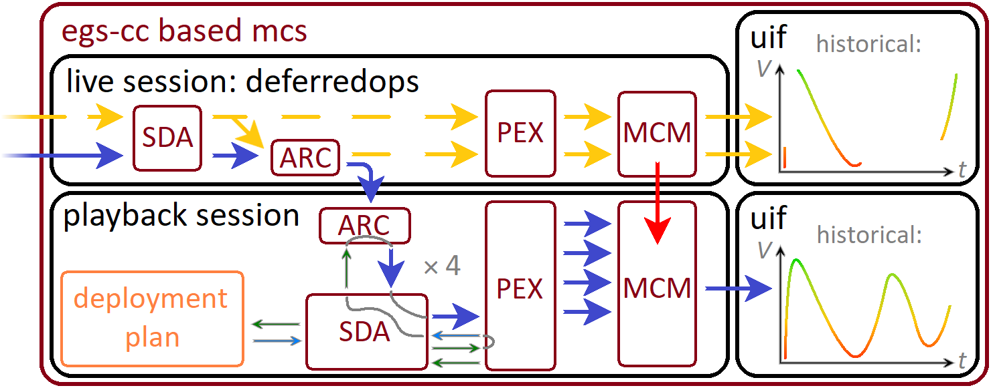
Rewinding the Clock: Playback Concepts in EGS-CC
For each time step, SDA → PEX → SDA → ARC → SDA → PEX loop repeats:

Slide 35
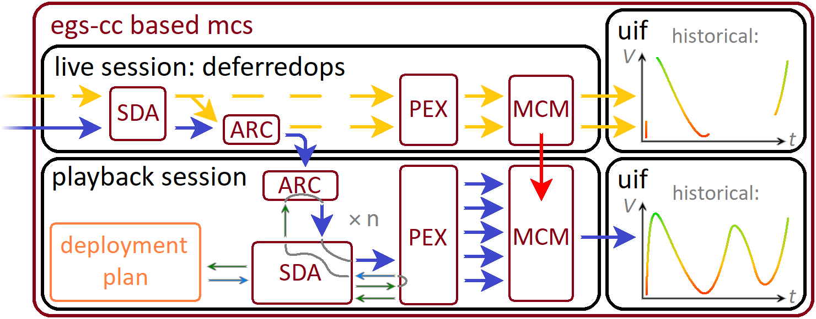
Rewinding the Clock: Playback Concepts in EGS-CC
Finally, playback historical display is complete:

Slide 36
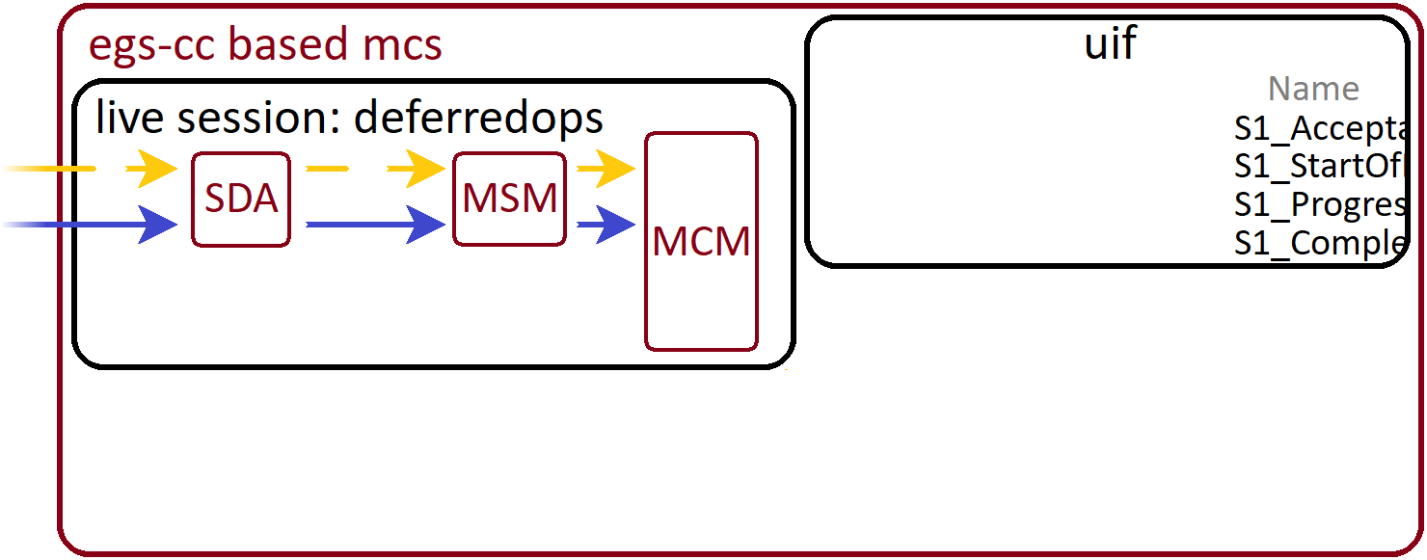
Rewinding the Clock: Playback Concepts in EGS-CC
Not all deferred data processed in playback session – see S1 verifications:

Slide 37
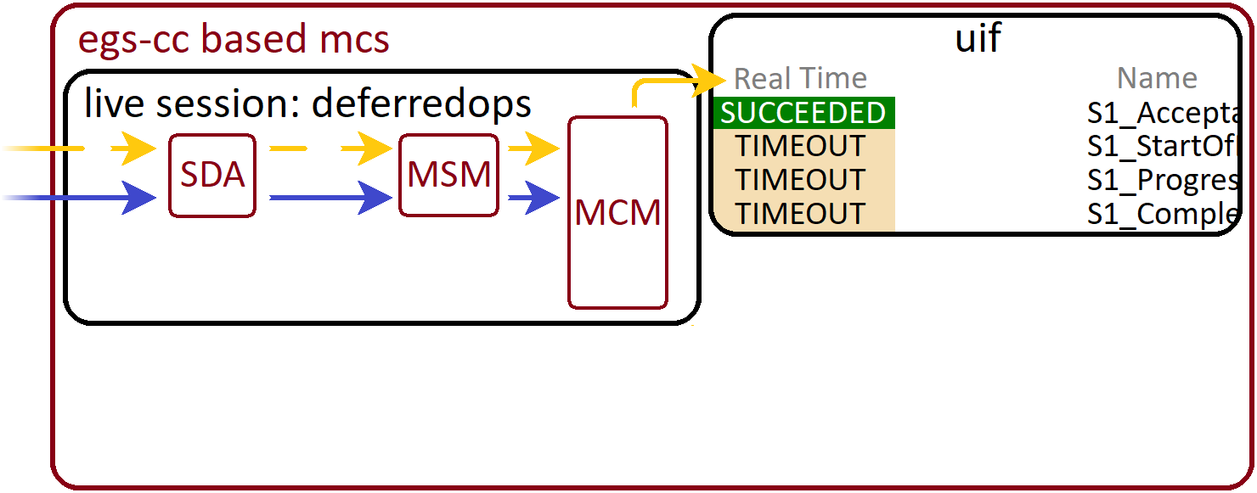
Rewinding the Clock: Playback Concepts in EGS-CC
Real time S1 verifications processed in live session:

Slide 38
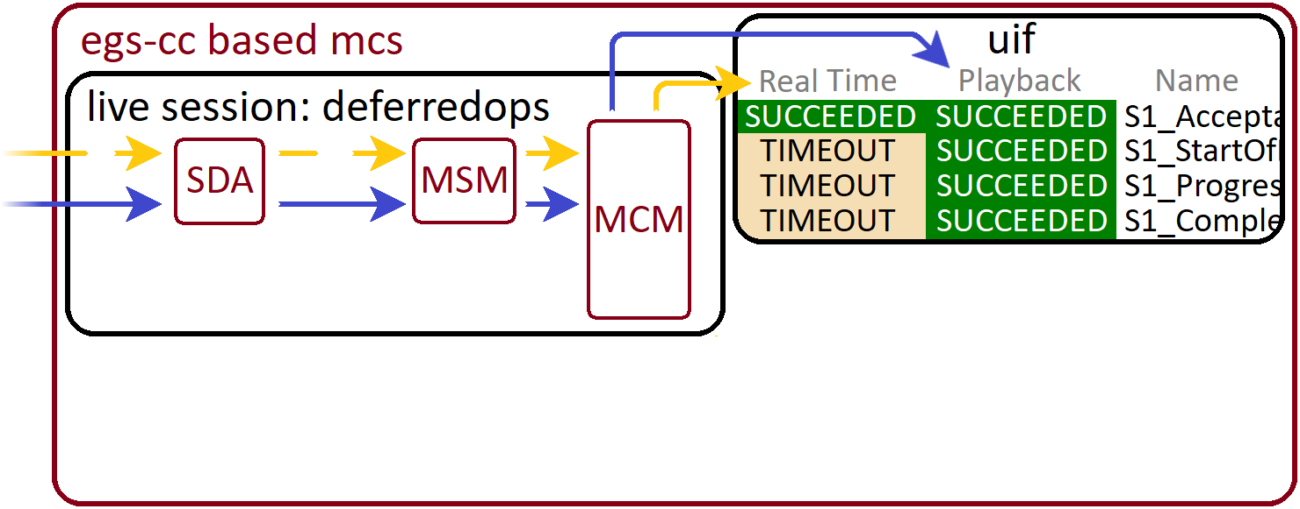
Rewinding the Clock: Playback Concepts in EGS-CC
Playback S1 verifications processed in live session too:

Slide 39
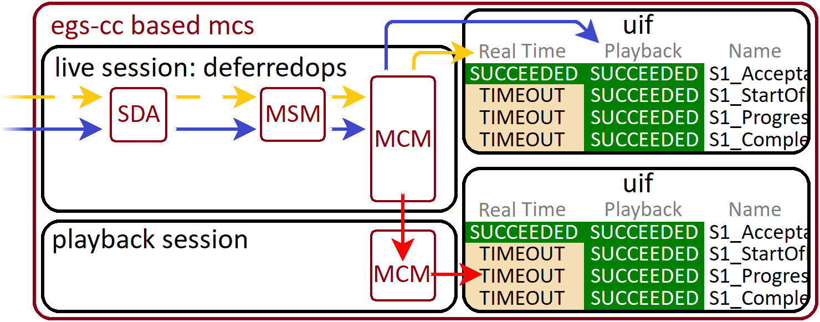
Rewinding the Clock: Playback Concepts in EGS-CC
In playback session, S1 verifications available via MCM Input Archive:

Slide 40
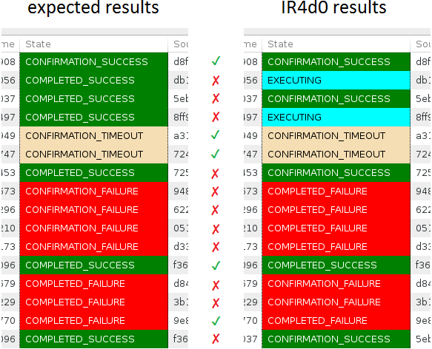
Rewinding the Clock: Playback Concepts in EGS-CC
current status:
S1 verification test script
sends various predefined
cases of verifications
work in progress
to cover all test cases

Slide 41
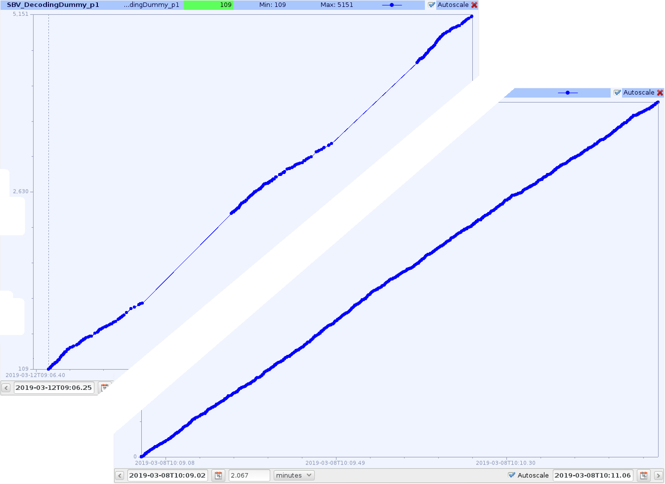
Rewinding the Clock: Playback Concepts in EGS-CC
current status:
playback session test script sends data with interruptions
later downlinks deferred data
playback overall working

Slide 42
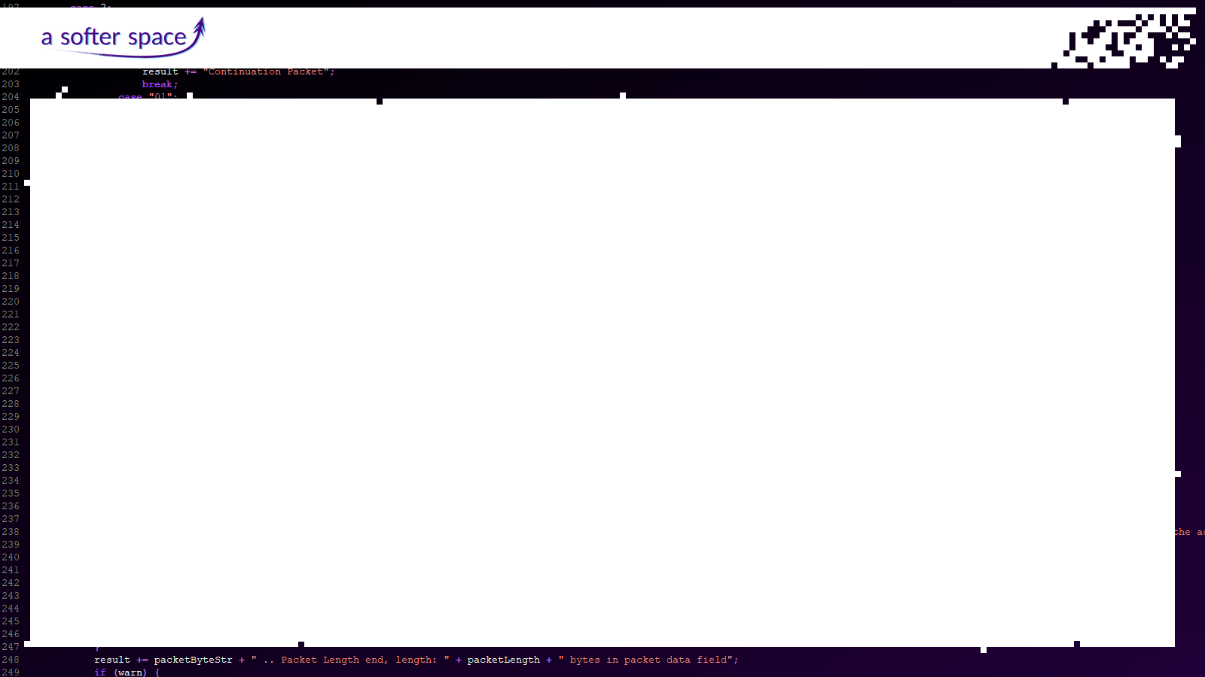
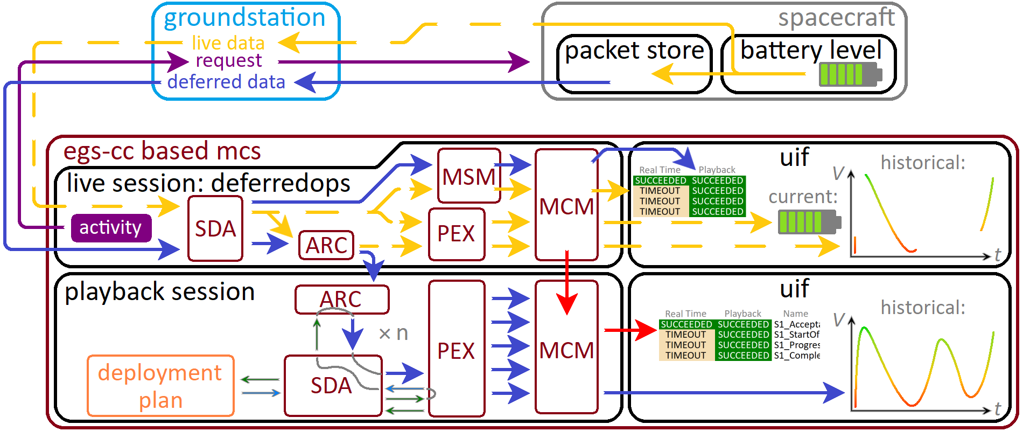
Rewinding the Clock: Playback Concepts in EGS-CC
Playback overview:

Slide 43
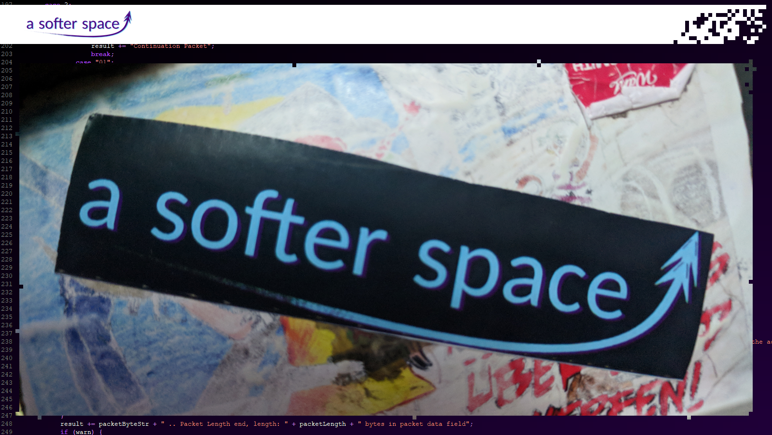
Rewinding the Clock: Playback Concepts in EGS-CC

