Slide 1
EKSE: A Command Line Interface for EGS-CC based Systems
Tom Moya Schiller
During conference: t_schiller@hotmail.com
28/05/2018

Slide 2
What is EGS-CC?
European Ground Systems Common Core
  Several Java components making up system core and reference implementation
  Service-oriented architecture based on OSGi allows easy extensibility
EGS-CC itself will be basis for various monitoring and control systems for missions in pre- and post-launch phases and even for ground stations
  EGS-CC based systems share common core and possibly parts of reference implementation
Test System Instance delivered as demonstration of core capabilities

Slide 3
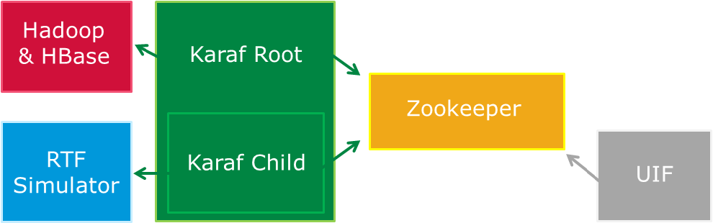
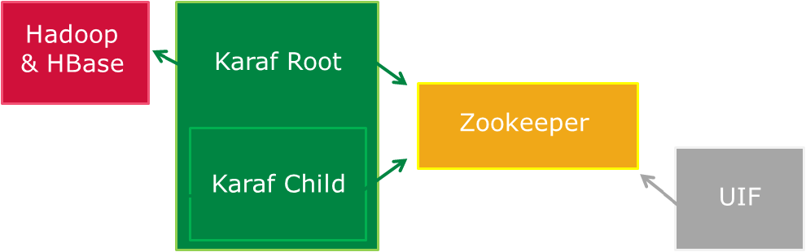
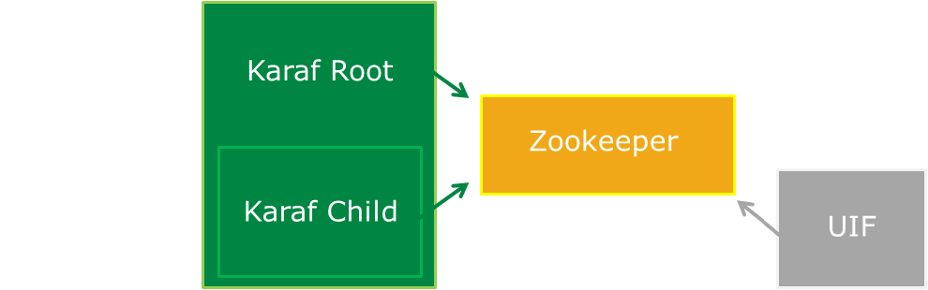

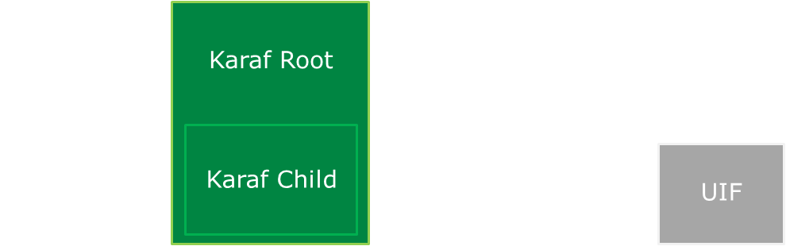
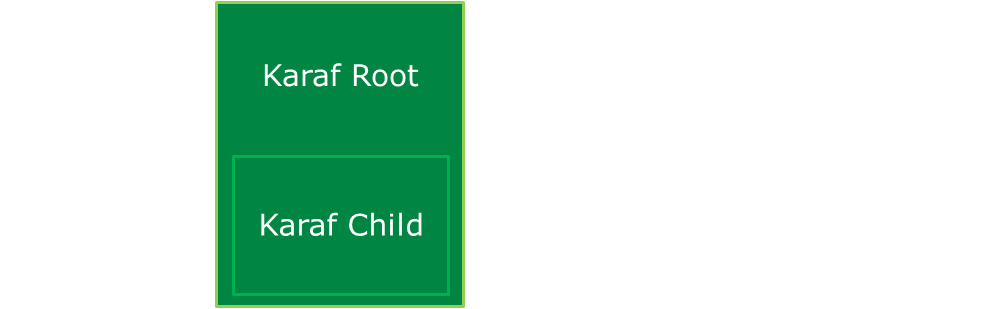
EGS-CC Test System Instance Overview
Long term storage
Backend container
Service discovery
Spacecraft
Simulator
Session child container
is one M&C system
Graphical
user interface

Slide 4
Starting Situation
Interaction with delivered EGS-CC Test System Instance only possible through User Interface (UIF) component
  Unclear whether front- or backend are responsible when problems are discovered
  Automating repetitive tasks in real running system based on UIF is challenging
Fine-grained documentation for individual API calls lacking, requiring explorative development
  Dynamic way of reloading source code into running Test System needed to avoid lengthy restarts between throwaway trial runs
Creation of new non-graphical interface for accessing EGS-CC-based systems

Slide 5
Use Cases
Simplifying usage of EGS-CC based system to counter steep learning curve
Enabling repeatable interactions with easy sharing and storage of outcomes
Enabling automation of individual or several test steps
Using direct access to components to determine where problems might be located
Enabling direct interaction with usually hidden local interfaces to more deeply analyse system under test
Enabling system administrator execution of basic tasks such as creating and starting sessions
Providing the means for exploratory development by allowing user to redefine scripts during runtime of EGS-CC based system
Improving speed of new developments by recombining existing building blocks

Slide 6
Possible Implementation Approaches
Expanding existing command line tool
  Script Execution Command Line already delivered as part of EGS-CC
Component not directly interactive but started again for each command
  Simplifies automation using shell scripts, as commands can be called directly from operating system terminals
  Introduces unnecessary overhead, as each time new connection to
  EGS-CC backend established
Ability to interactively access a running EGS-CC based system seen as too fundamental to go ahead using this component only

Slide 7
Possible Implementation Approaches
Creating new fully external program connecting to EGS-CC based system
At the time, EGS-CC only accessible via local infrastructure component and OSGi services (no REST API, CORBA interface, etc.)
  Adapter component inside EGS-CC paired with external program would be possible but unnecessarily difficult
Command line could be traditional program running as part of a terminal session or graphical program showing a terminal-like environment to the user
Referred to as ESCLI – EGS-CC Standalone Command Line Interface

Slide 8
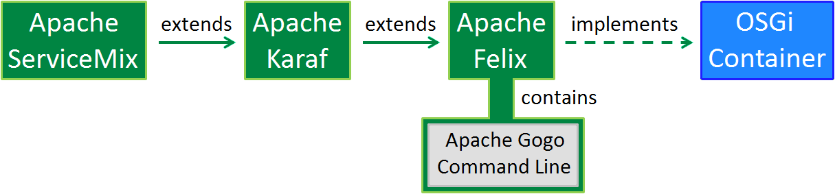
Possible Implementation Approaches
Extending existing application instead of creating entirely new one
Karaf container used already within EGS-CC, containing Gogo command line:
Re-using application already used in
EGS-CC adds functionality without adding complexity for the user
Referred to as EKSE - EGS-CC Karaf Shell Extension

Slide 9
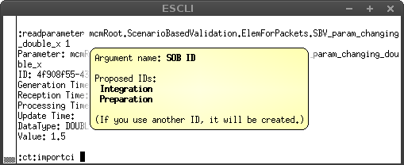
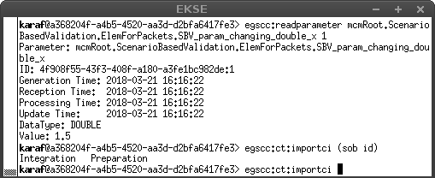
Possible Implementation Approaches
Creating completely new graphical application implementing simple command line would give large freedom, e.g. for displaying hints:
Ultimately re-using simple console more maintainable though

Slide 10
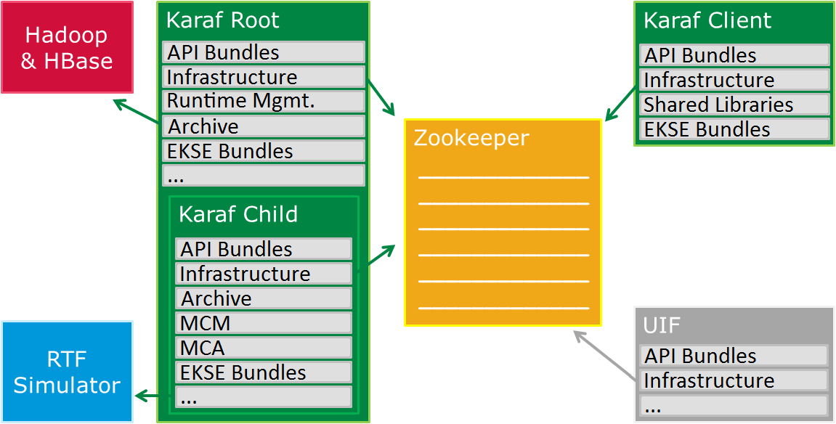
Deployment Options
Embedded in root container (e.g. for session startup)
Embedded in external OSGi client application
Embedded in session container (e.g. for parameter access)

Slide 11
Scripting Approach
EKSE component itself is light-weight generic container
Most capabilities added through Groovy scripts which can be edited by the user, with currently 128 scripts already included
Scripts are building blocks which can depend on each other
  Increasingly complex interactions with EGS-CC based systems can be created and adjusted quickly and easily

Slide 12
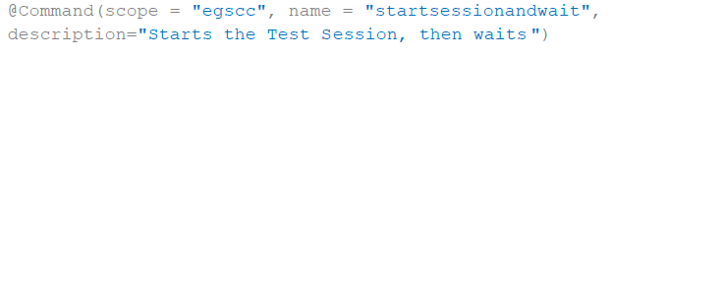
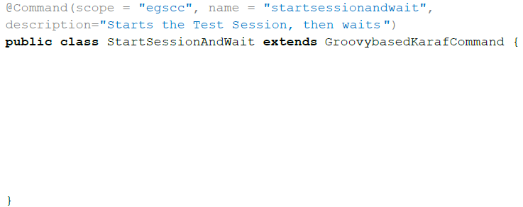
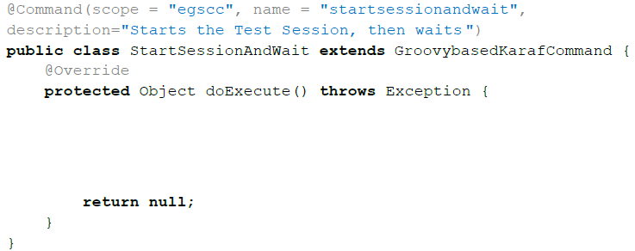
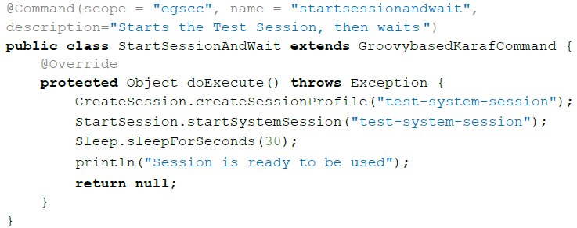
Example Script

Slide 13
Enabling Dynamic Interactions
EKSE scripts can be edited at runtime
Allow exploratory development using quick cycles of source code changes and testing these changes in running system
Scripts synchronized between different containers and different users using git
Even more dynamic approach possible using interactive mode
  Instead of creating whole script at once, interaction with the backend line-by-line

Slide 14
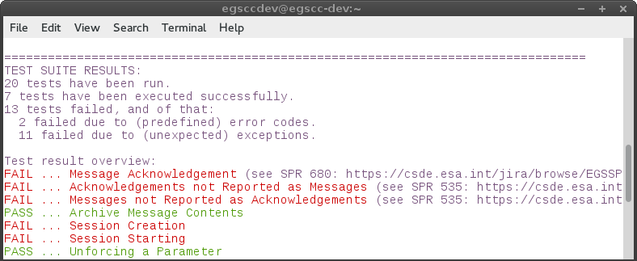
Automation of Tests
EKSE allows automation of tests with light weight testing framework entirely provided in the form of modifiable Groovy scripts

Slide 15
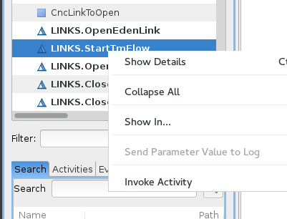
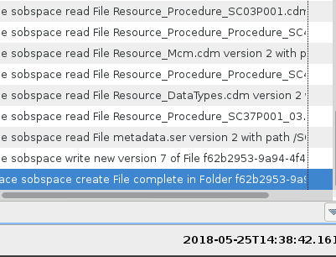
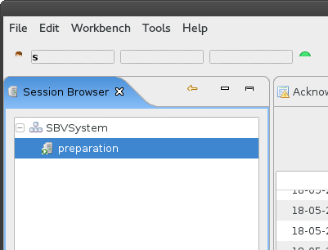
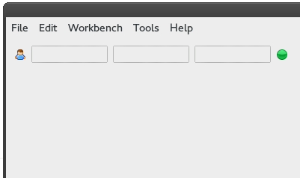
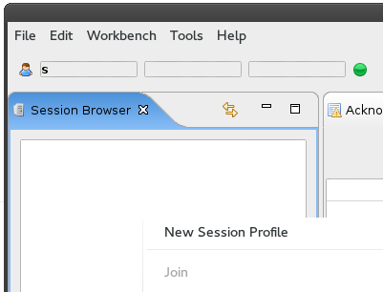
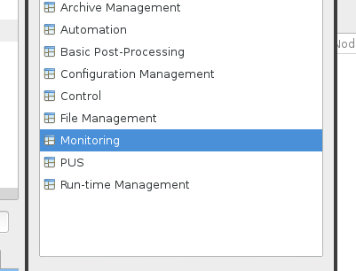
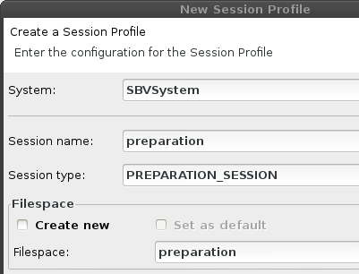
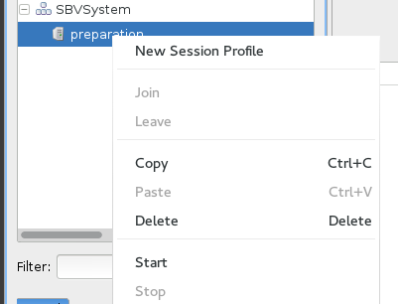
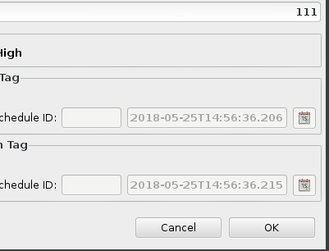
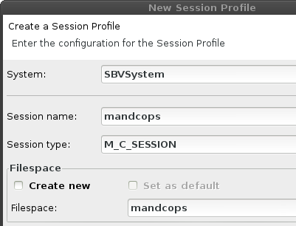
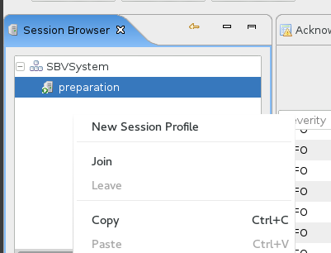
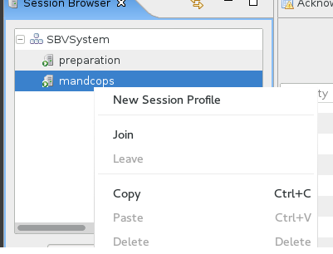
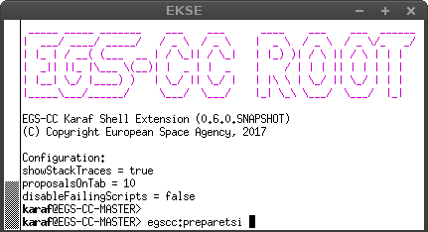
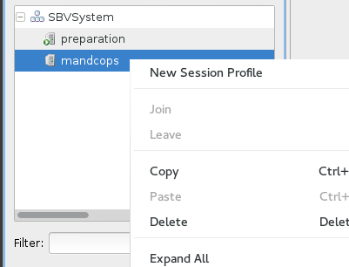
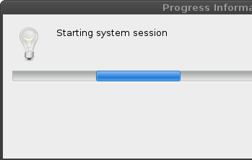
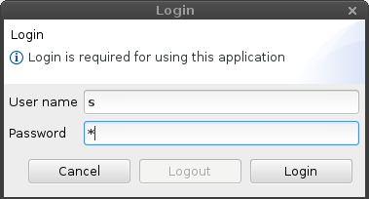
Automation of Common Interactions
Startup of Test System Instance in EKSE:
Manual startup without EKSE:
Large time reduction in common interactions with EGS-CC Test System Instance by using EKSE
Enter egscc:preparetsi
Wait until sessions have been started
Then create a new session profile
Enter mandcops session configuration
Start the mandcops session
… await completion message
… and invoke it
Select the StartTmFlow activity…
Switch to Monitoring perspective
Join the mandcops session
Await session startup
After session has started…
Start preparation session
Log in
Enter login credentials
Create New Session Profile
Enter preparation session data

Slide 16
Configuration Tracking Interface
Configuration tracking in EGS-CC allows handling different versions of monitored systems and clearly identifying used versions
Ability originally foreseen with graphical interface
Performed by system administrators, possibly for several machines
  Command line based interactions preferred
21 scripts created as configuration tracking interface based on EKSE:
egscc:ct:assignsobtosession egscc:ct:discardsobchanges egscc:ct:listcommittedsobs
egscc:ct:commitsob egscc:ct:displaysob egscc:ct:listopensobs
egscc:ct:copycitosob egscc:ct:editsob egscc:ct:listsobs
egscc:ct:copysob egscc:ct:enablesobstrapper egscc:ct:opensob
egscc:ct:createsob egscc:ct:exportci egscc:ct:refreshsob
egscc:ct:deletesob egscc:ct:importci egscc:ct:removecifromsob
egscc:ct:disablesobstrapper egscc:ct:listcis egscc:ct:validatesob

Slide 17
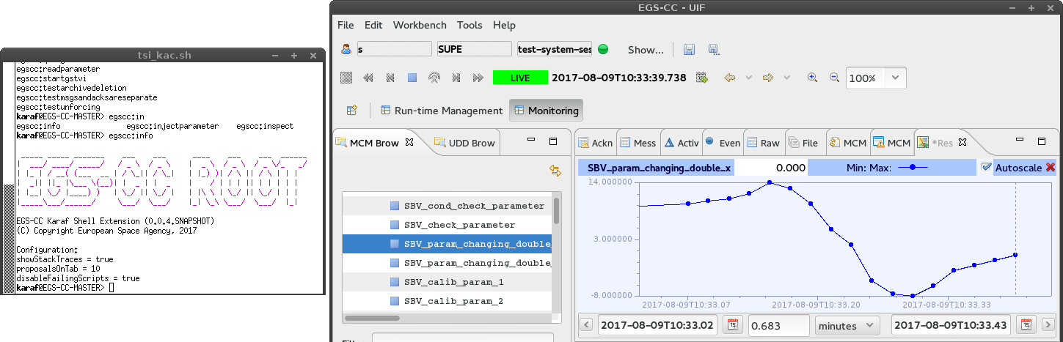
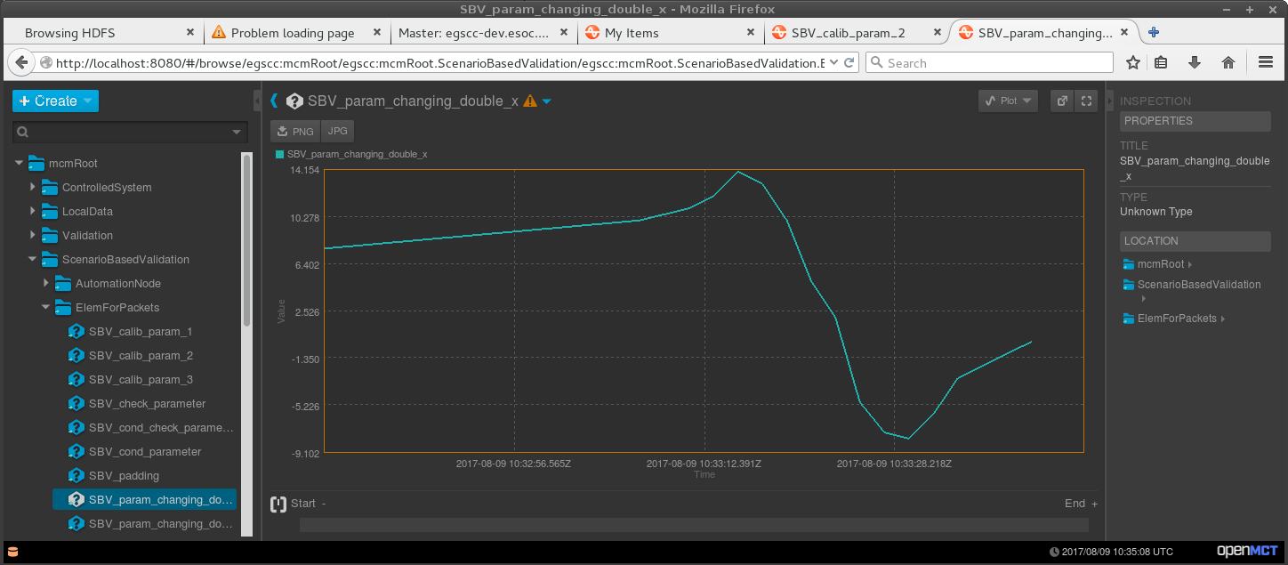
Ad-hoc Basis for Further Extension
EKSE scripts can serve as ad-hoc adapters
  Enable quick and simple connection to external systems for technology demonstrations and prototypes
Example: Connecting EGS-CC to Open MCT by NASA
  Connection and first demonstration achieved within one day

Slide 18
Challenges
Scripting coordination between different users adjusting scripts for their own needs can be challenging
Variable nature of scripts leads to unusual software life cycle
  EKSE core component only changed a few times a year
  Scripts can be updated many times daily
Scripts originally foreseen for throwaway tests can be difficult to scale up for realistically sized systems
  Work of transferring scripts into generic EGS-CC toolkit still ongoing

Slide 19
Conclusions
EKSE has been used to more clearly understand origins of various SPRs in the EGS-CC project
Demonstrates easy extensibility of EGS-CC based systems
EKSE is used daily by several developers, so far especially at ESOC but also in other locations
  Create quick test scripts for investigating system behavior
  Automate various repetitive interactions with the EGS-CC Test System Instance
Re-using existing Karaf console seems to have been a good idea, as identified disadvantages could be largely circumvented

